Slide 1

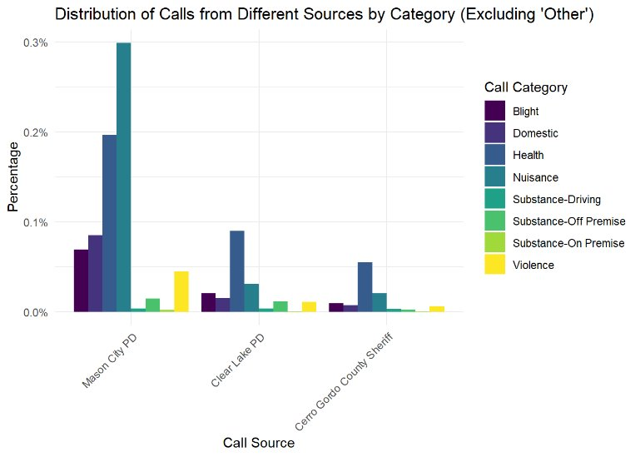
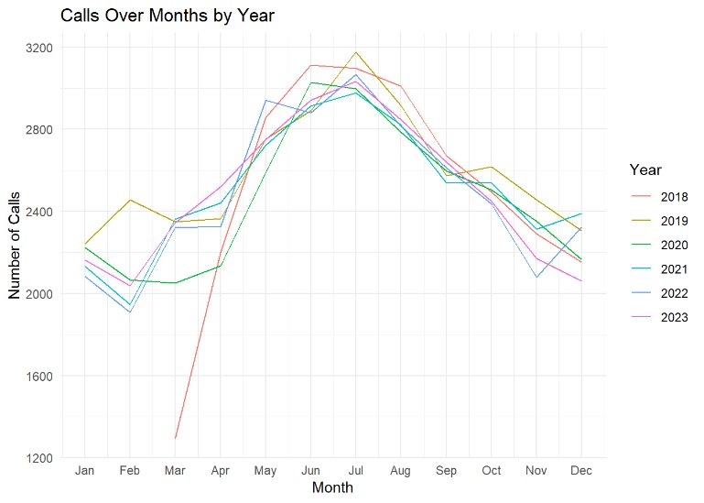
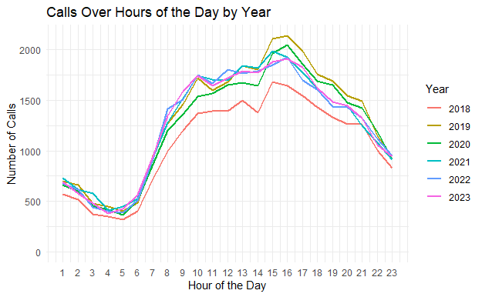
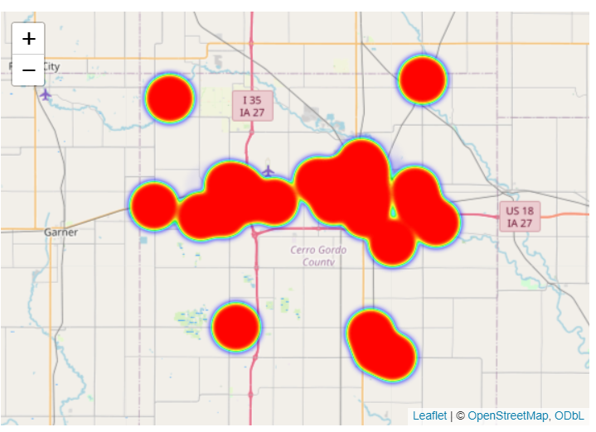
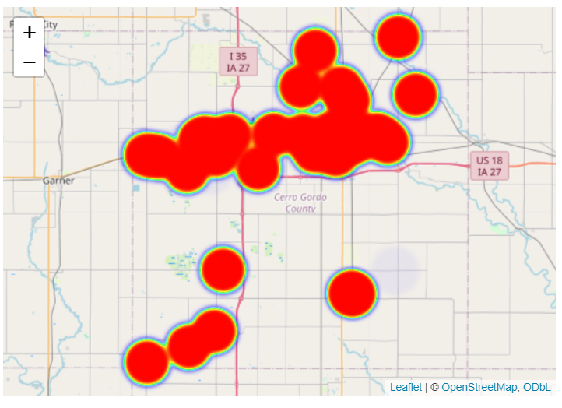
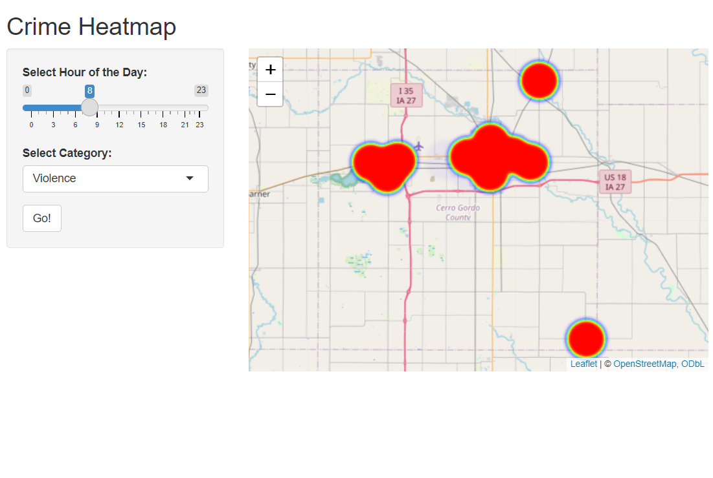
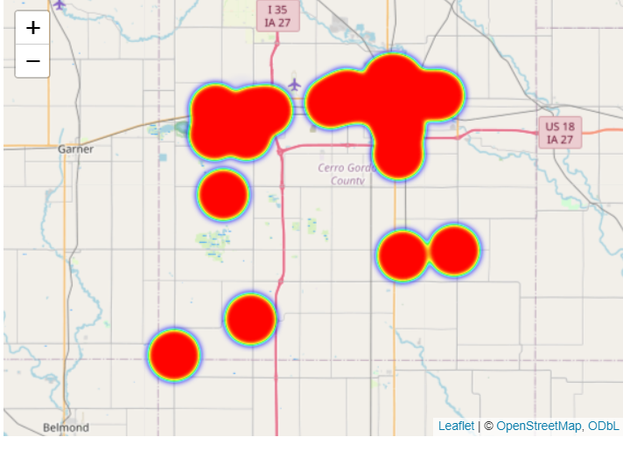
Data Science
DS401 Capstone
5/3/2024
Neha Maddali, Alexis Maldonado, Pramit Vyas
Predict-Align-Prevent Model to Improve Health and Safety
Communities nationwide face escalating challenges related to crime, substance abuse, and public safety. In recent years, alarming increases in property and violent crimes, alongside persistent issues such as substance abuse and firearm-related fatalities, have underscored the urgent need for proactive interventions.
DATA INSIGHTS: Cerro Gordo County, IA call for service from March 2018-2023
MODELING:
Logistic Regression: train multiple models to make predictions
Goal: Predict the presence of theft or shoplifting in block group
F1: score 0.81, Accuracy: 0.68
Random Forest: Build many decision trees and combine their predictions
Goal: Predict Nuisance calls per hour
11.09% out of bag misclassification rate
Neural Networks: use non-linear activation function to connect neurons through layers for predictions
Goal: Predict Violence related calls for a given hour
Achieved MAE of .998 with a Recurrent Neural Network
Distribution of calls across Mason City, Clear Lake, and County Sherriff. In all 3 jurisdictions, we can see that the categories Health and Nuisance made up most of the calls.
Time series of service calls over months of the years. A consistent trend across the 5 years indicating that the calls increase from May through July and then decreases as approaching December.
PREDICT when and where incidents will occur to ALIGN resources to PREVENT these incidents from occurring in the future.
Done in collaboration with the Public Science Collaborative
Nuisance related calls at 8:00 am
Nuisance related calls at 9:00 pm
Time series of service calls over hours of the day by years in the data. A clear trend over the 5 years is seen that between 8 am and 8 pm calls are at the highest, with 4 pm being the peak.
Violence related calls at 8:00 am
Violence related calls at 9:00 pm

